Slide 1
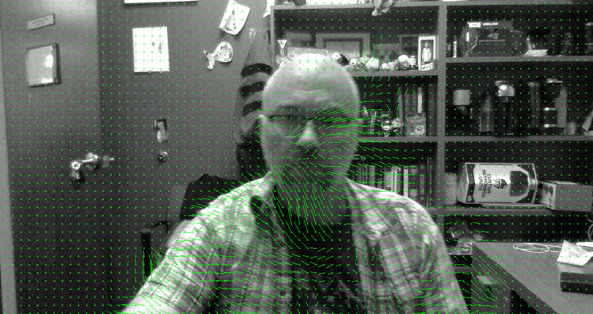
Lecture 17 Object Tracking
ECE 1390/2390

Slide 2
Syllabus
Week | Date | Topic | In class work | Due date
1 | 8/25/2025 | Introduction to course | Intro to OpenCV (HW0) | Due 9/1
 | 8/27/2025 | Image operations | Planning projects
2 | 9/1/2025 | Labor Day [No Class]
 | 9/3/2025 | Analysis and Color spaces | Initial project proposal
3 | 9/8/2025 | Image Transforms | Python problems (HW1) | Due 9/15
 | 9/10/2025 | Spatial & Frequency Filtering | Group Project work | White paper on project
4 | 9/15/2025 | Image Restoration/Inverse filters | Python problems (HW2) | Due 9/22
 | 9/17/2025 | Edge Detection | Group Project work
5 | 9/22/2025 | GMM Segmentation | Python problems (HW3) | Due 9/29
 | 9/24/2025 | Image Feature Detection | Python problems (HW4) | Due 10/1
6 | 9/29/2025 | Registration & Homography | Group Project work
 | 10/1/2025 | Computational Photography | Python problems (HW5) | Due 10/8
7 | 10/6/2025 | Camera Calibration
 | 10/8/2025 | Depth & 3D Reconstruction

Slide 3
Syllabus
Week | Date | Topic | In class work | Due date
8 | 10/13/2024 | Camera Calibration
 | 10/15/2024 | Depth & 3D Reconstruction
9 | 10/20/2024 | Haar Cascade Classifiers
 | 10/22/2024 | Object Tracking
10 | 10/27/2024
 | 10/29/2024
11 | 11/3/2024 | OCR Text Detection | HW 6- Camera Calibration | HW1-5 due!!!!!!
 | 11/5/2024 | Media Pipe
12 | 11/10/2024 | Image Compression |  | HW6 due
 | 11/12/2024 | In class finish projects | HW7- Object tracking
13 | 11/17/2024 | Final Project Presentations
 | 11/19/2024 | Final Project Presentations | HW8- OCR/Media Pipe | HW7 due
14 | 11/24/2024 | Thanksgiving recess
 | 11/26/2024 | Thanksgiving recess
15 | 12/1/2024 | OpenCV DNN
 | 12/3/2024 | Super Resolution |  | HW8 due

Slide 4
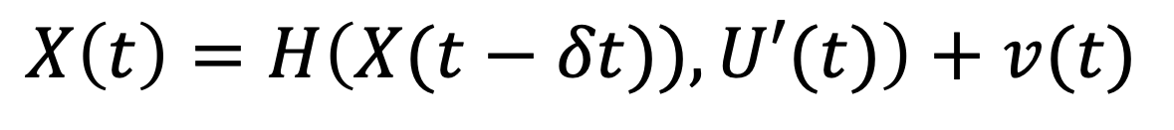
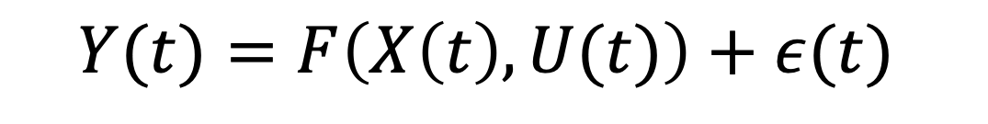
Kalman Filter
Model (e.g. physics) based tracking
Measurement noise
Measurement (Lead field) model
Observation layer
Observations
$$Y(t)=F\left(X\left(t\right),U(t)\right)+ε(t)$$
Control/Input vector [optional]
State/process noise
Hidden-state layer
States
$$X\left(t\right)=H\left(X(t−δt)),U′(t)\right)+v(t)$$
State update model

Slide 5
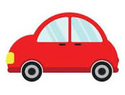

Example
Observation Layer
$\left[\begin{matrix}Y_{lat}[n] \\ Y_{long}[n]\end{matrix}\right]$= $\left[\begin{matrix}X_{lat}[n] \\ X_{long}[n]\end{matrix}\right]+ε$
Position Layer
$\left[\begin{matrix}X_{lat}[n] \\ X_{long}[n]\end{matrix}\right]=\left[\begin{matrix}X_{lat}[n−1] \\ X_{long}[n−1]\end{matrix}\right]$+$T∙\left[\begin{matrix}cos⁡(θ\left[n\right]) & sin⁡(θ\left[n\right]) \\ −sin⁡(θ\left[n\right]) & cos⁡(θ\left[n\right])\end{matrix}\right]∙V_{elocity}\left[n\right]+p$
Velocity Layer
$\left[\begin{matrix}V_{elocity}\left[n\right] \\ θ[n]\end{matrix}\right]=\left[\begin{matrix}V_{elocity} [n−1] \\ θ[n−1]\end{matrix}\right]$+ $T∙ \left[\begin{matrix}A_{cc}[n] \\ W_{acc}[n]\end{matrix}\right]+v$
Acceleration Layer
$$\left[\begin{matrix}A_{cc}[n] \\ W_{acc}[n]\end{matrix}\right]=\left[\begin{matrix}A_{cc}[n−1] \\ W_{acc}[n−1]\end{matrix}\right]+ω$$

Slide 6
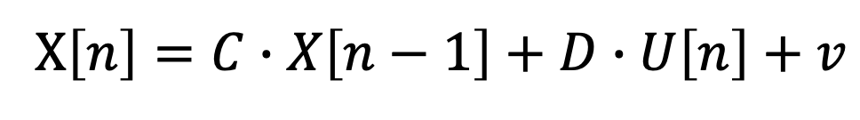
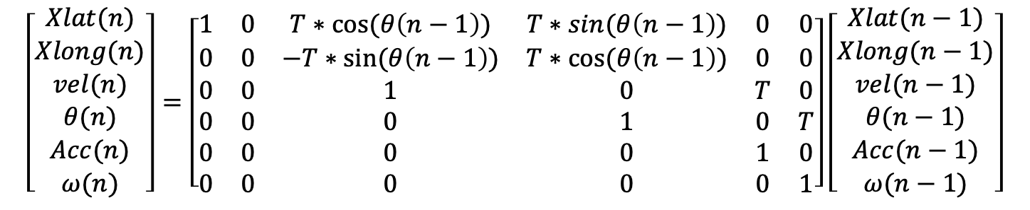
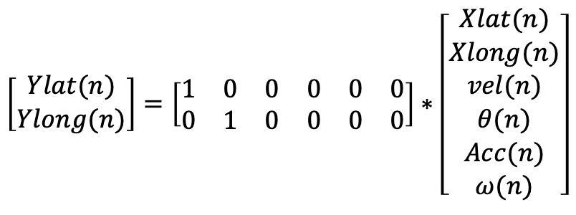
Example
$$Y\left[n\right]=A∙X\left[n\right]+B∙U\left[n\right]+e$$
$$\left[\begin{matrix}Ylat(n) \\ Ylong(n)\end{matrix}\right]=\left[\begin{matrix}1 & 0 & 0 & 0 & 0 & 0 \\ 0 & 1 & 0 & 0 & 0 & 0\end{matrix}\right]∗\left[\begin{matrix}Xlat(n) \\ Xlong(n) \\ vel(n) \\ θ(n) \\ Acc(n) \\ ω(n)\end{matrix}\right]$$
X$\left[n\right]=C∙X\left[n−1\right]+D∙U\left[n\right]+v$
$$\left[\begin{matrix}Xlat(n) \\ Xlong(n) \\ vel(n) \\ θ(n) \\ Acc(n) \\ ω(n)\end{matrix}\right]=\left[\begin{matrix}1 & 0 & T∗cos⁡(θ\left(n−1\right)) & T∗sin⁡(θ\left(n−1\right)) & 0 & 0 \\ 0 & 0 & −T∗sin⁡(θ\left(n−1\right)) & T∗cos⁡(θ\left(n−1\right)) & 0 & 0 \\ 0 & 0 & 1 & 0 & T & 0 \\ 0 & 0 & 0 & 1 & 0 & T \\ 0 & 0 & 0 & 0 & 1 & 0 \\ 0 & 0 & 0 & 0 & 0 & 1\end{matrix}\right]\left[\begin{matrix}Xlat(n−1) \\ Xlong(n−1) \\ vel(n−1) \\ θ(n−1) \\ Acc(n−1) \\ ω(n−1)\end{matrix}\right]$$

Slide 7
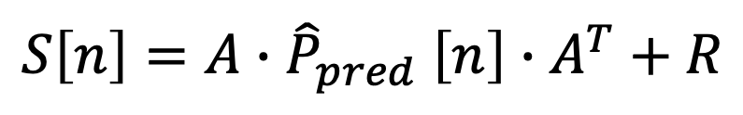
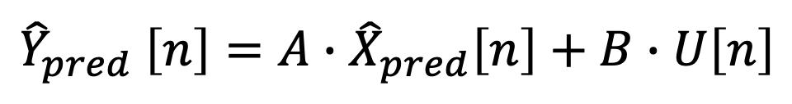
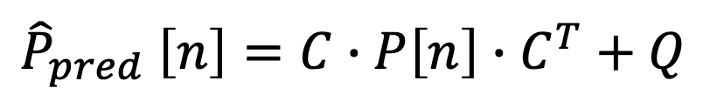
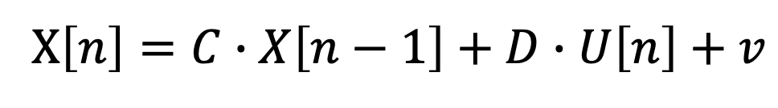
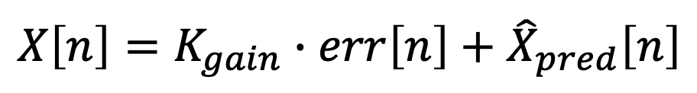
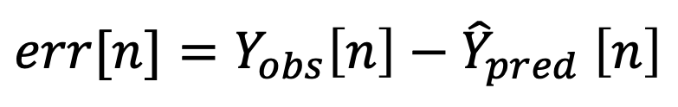
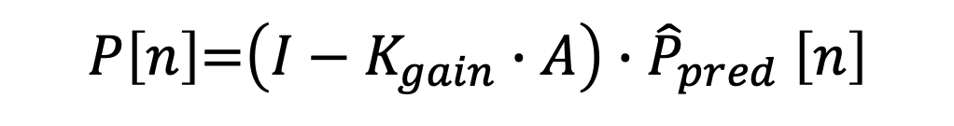
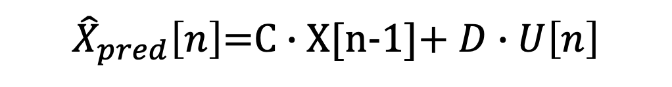
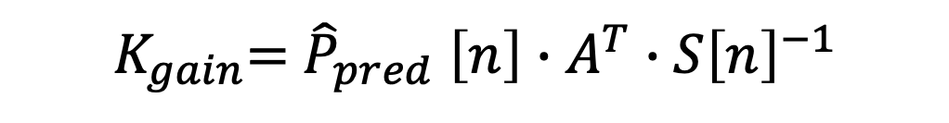
$$Y\left[n\right]=A∙X\left[n\right]+B∙U\left[n\right]+e$$
X$\left[n\right]=C∙X\left[n−1\right]+D∙U\left[n\right]+v$
${\hat{X}}_{pred}\left[n\right]$=C $∙$X[n-1]+ $D∙U\left[n\right]$
$${\hat{Y}}_{pred} \left[n\right]=A∙{\hat{X}}_{pred}\left[n\right]+B∙U\left[n\right]$$
Prediction
$${\hat{P}}_{pred} \left[n\right]=C∙P\left[n\right]∙C^{T}+Q$$
$$err[n]={Y_{obs}\left[n\right]−\hat{Y}}_{pred} \left[n\right]$$
$$S\left[n\right]={A∙\hat{P}}_{pred} \left[n\right]∙A^{T}+R$$
Update
$K_{gain}$= ${\hat{P}}_{pred} \left[n\right]∙{A^{T}∙S\left[n\right]}^{−1}$
$$X\left[n\right]=K_{gain}∙err\left[n\right]+{\hat{X}}_{pred}\left[n\right]$$
Correction
$P\left[n\right]$=$\left(I−K_{gain}∙A\right)∙{\hat{P}}_{pred} \left[n\right]$

Slide 8
>> A=eye(2);
>> nk=1000;
>> xtrue = [[1:nk]./200.*sin([1:nk]/50);...
[1:nk]./200.*cos([1:nk]/50)];
>> y=A*xtrue+randn(2,nk)/3;
R=.1*eye(2);
Q=.2*eye(2);
x=zeros(2,nk);
P=eye(2);
for k=2:nk
xhat=C*x(:,k-1);
yhat = A*xhat;
Phat = C*P*C'+Q;
err = y(:,k)-yhat;
S = A*Phat*A'+R;
K = Phat*A'*inv(S);
x(:,k)=xhat+K*err;
P=(eye(2)-K*A)*Phat;
end

Slide 9
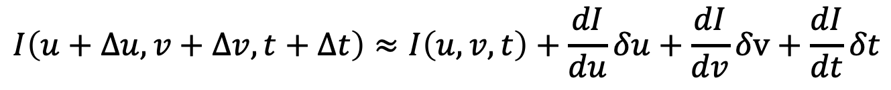
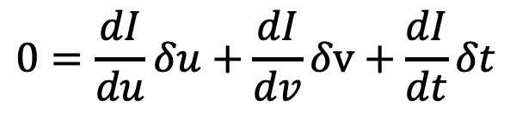
Optical Flow
$$I\left(u,v,t\right)→I\left(u+∆u,v+∆v,t+∆t\right)$$
Taylor expansion
$$I\left(u+∆u,v+∆v,t+∆t\right)≈I\left(u,v,t\right)+\frac{dI}{du}δu+\frac{dI}{dv}δv+\frac{dI}{dt}δt$$
Assume that intensity doesn’t change (just moves around)
$$I\left(u,v,t\right)=I\left(u+∆u,v+∆v,t+∆t\right)$$
$$0=\frac{dI}{du}δu+\frac{dI}{dv}δv+\frac{dI}{dt}δt$$

Slide 10
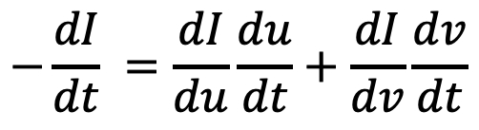
Optical Flow
Unknowns (du/dt & dv/dt)
$$−\frac{dI}{dt} =\frac{dI}{du}\frac{du}{dt}+\frac{dI}{dv}\frac{dv}{dt}$$
Change in intensity at pixel
Gradient in horizontal (u)
Gradient in vertical (v)
Each pixel has one equation and two unknowns
Lucas-Kanade Method (Sparse flow)
Gunnar Farneback Method (dense flow)

Slide 11
Optical Flow
Lucas-Kanade Method (Sparse flow)
Track only corner points
Find Shi-Tomasi points between frames (cv2.goodPointsToTrack(.) )
# params for corner detection
feature_params = dict( maxCorners = 100, qualityLevel = 0.3, minDistance = 7, blockSize = 7 )
# Parameters for lucas kanade optical flow
lk_params = dict( winSize = (15, 15), maxLevel = 2, criteria = (cv2.TERM_CRITERIA_EPS |cv2.TERM_CRITERIA_COUNT,10, 0.03))
old_pts = cv2.goodFeaturesToTrack(old_gray, mask = None, **feature_params)
New_pts, status, err = cv2.calcOpticalFlowPyrLK(old_gray, new_gray, old_pts, None, **lk_params)
# Select good points
good_new = new_pts[status == 1]
good_old = old_pts[status == 1]

Slide 12
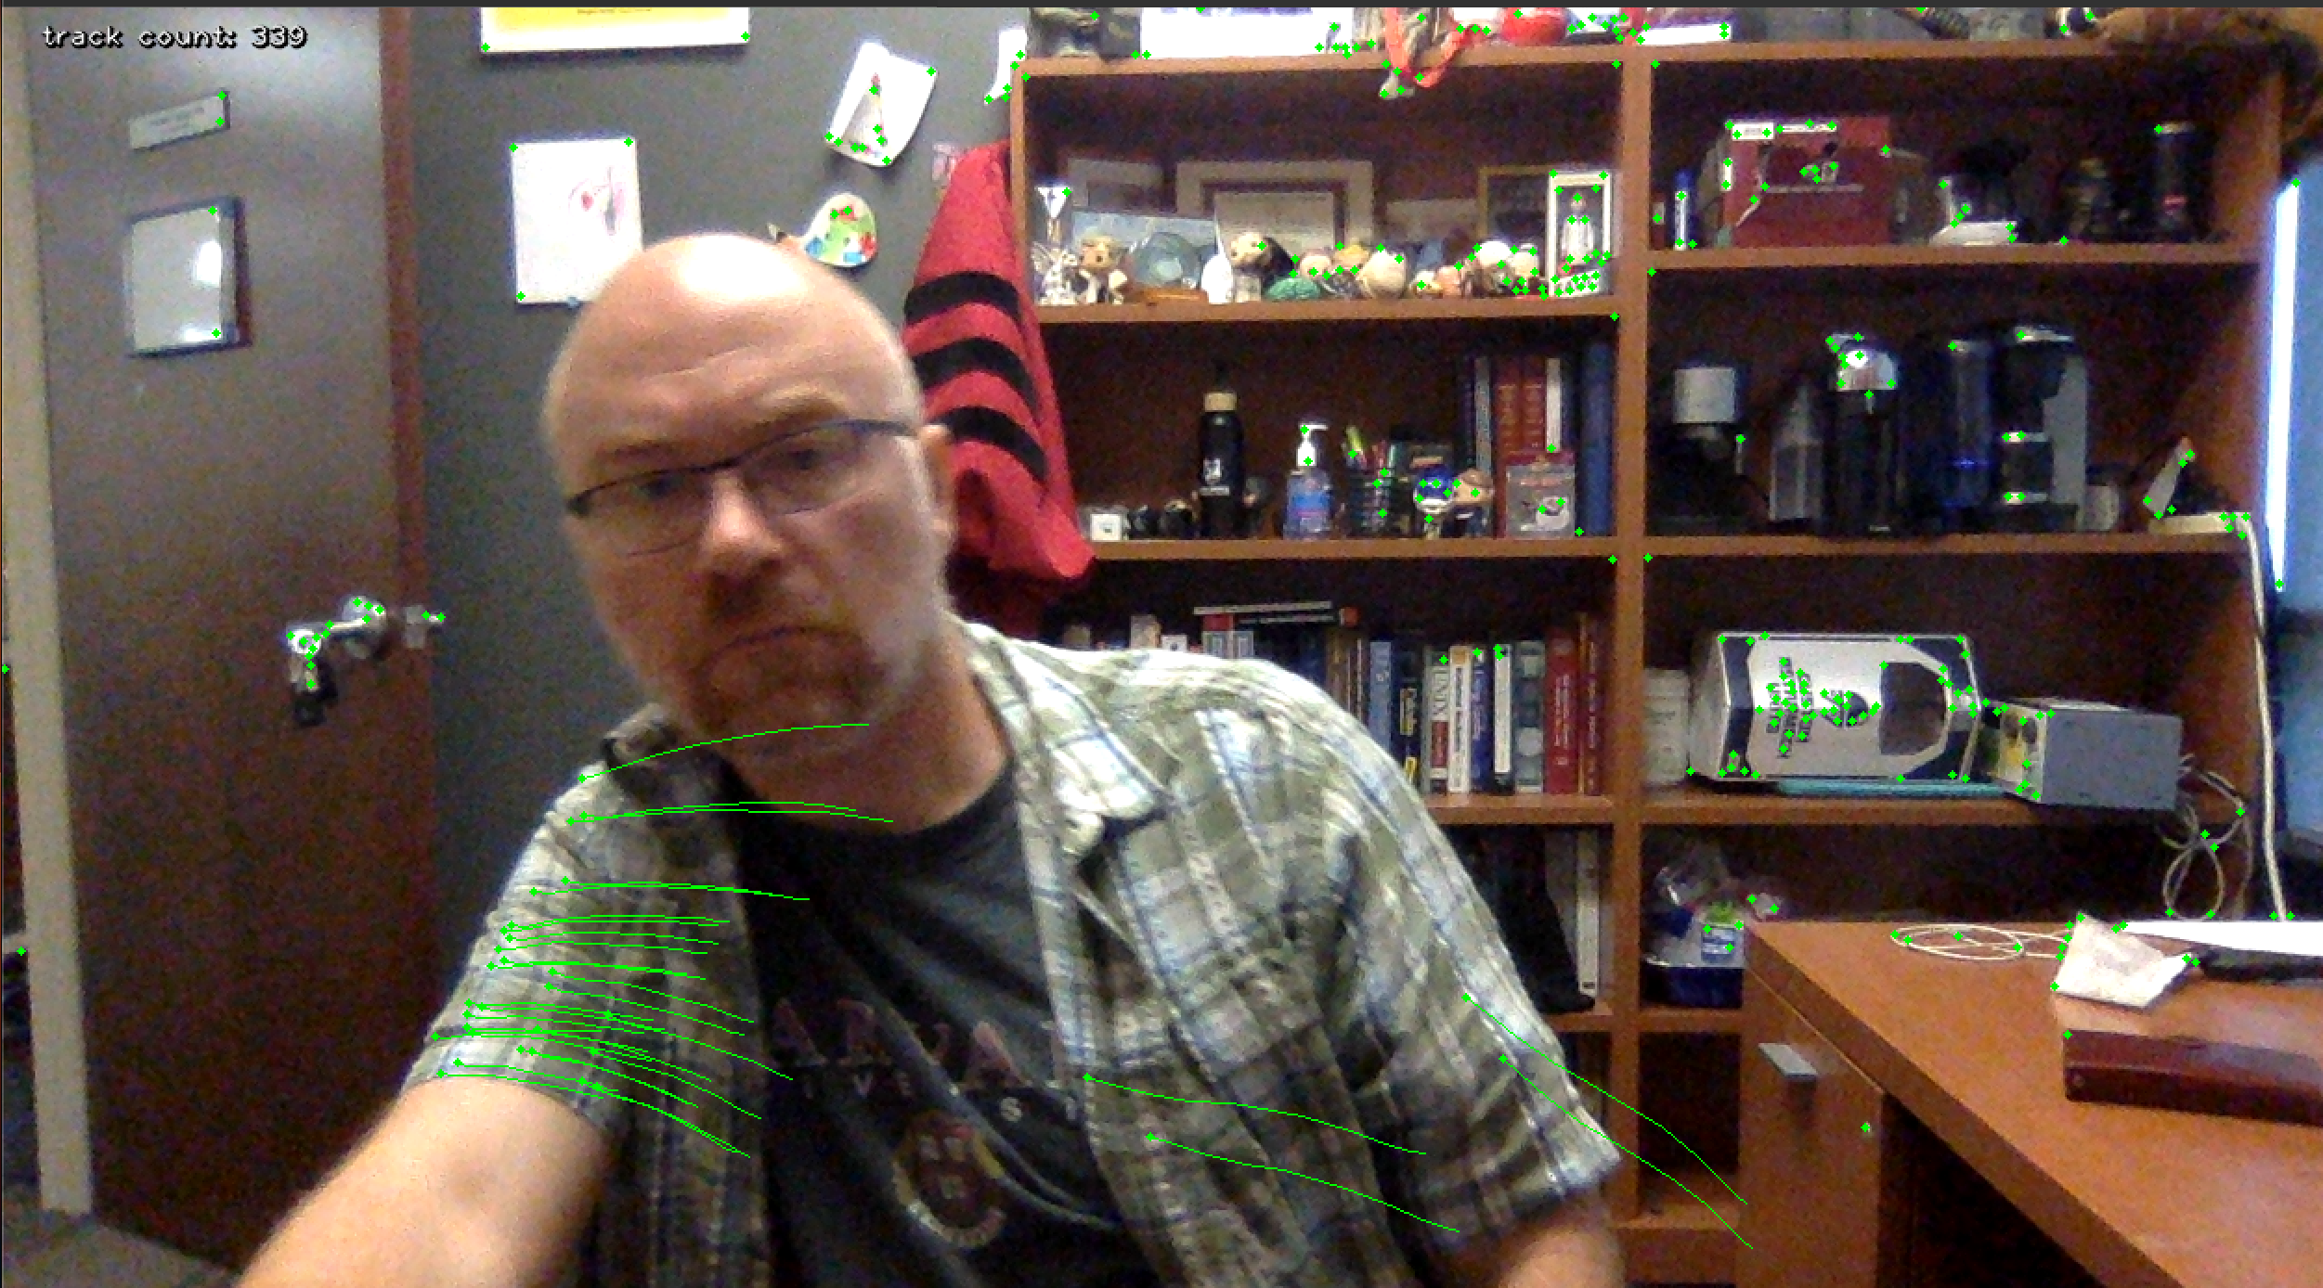
Optical Flow
Lucas-Kanade Method (Sparse flow)

Slide 13
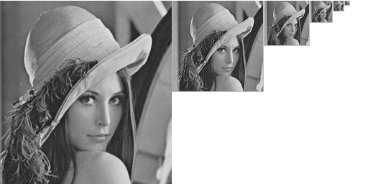
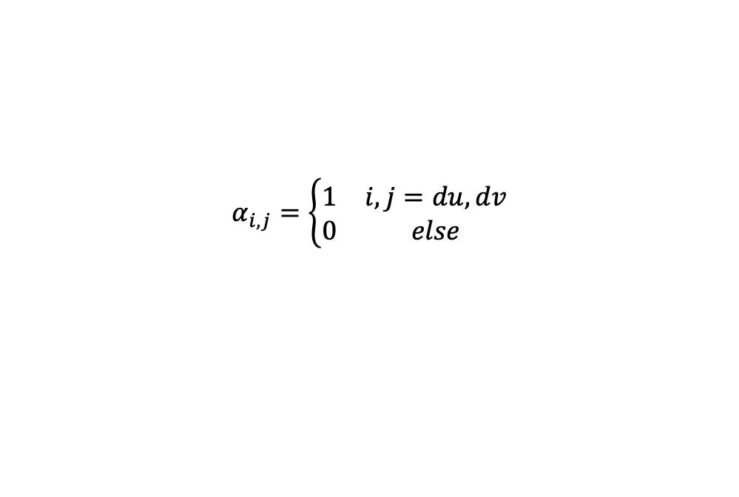
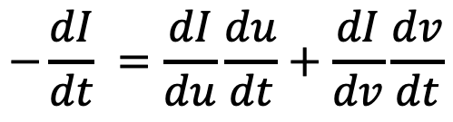
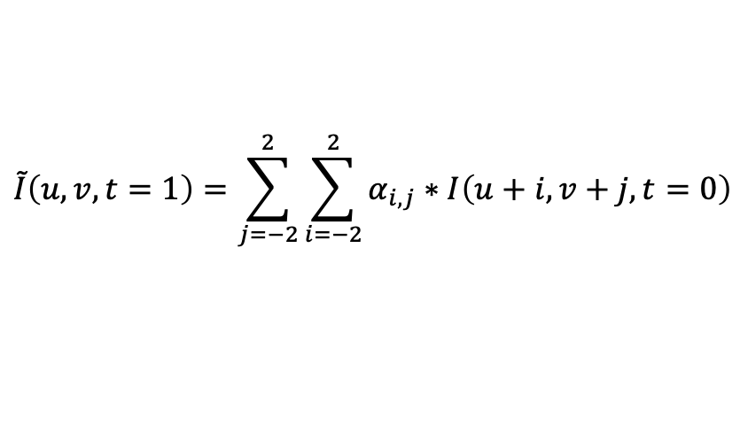
Optical Flow
$$−\frac{dI}{dt} =\frac{dI}{du}\frac{du}{dt}+\frac{dI}{dv}\frac{dv}{dt}$$
Gunnar Farneback Method (dense flow)
Make image pyramid
Polynomial Approximation
$$\tilde{I}\left(u,v,t=1\right)=\sum_{j=−2}^{2}{\sum_{i=−2}^{2}{α_{i,j}∗I\left(u+i,v+j,t=0\right)}}$$
Small movements
Larger movements →
Iterative estimate du & dv
$I\left(u,v,t=0\right)−I\left(u,v,t=1\right)=\frac{d\tilde{I}\left(u,v\right)}{du}\frac{du}{dt}+$ $\frac{d\tilde{I}\left(u,v\right)}{dv}\frac{dv}{dt}$
$$α_{i,j}=\left\{\begin{matrix}1 & i,j=du,dv \\ 0 & else\end{matrix}\right.$$

Slide 14
Optical Flow
Gunnar Farneback Method (dense flow)
flow = cv2.calcOpticalFlowFarneback(old_gray_img, new_gray_img,
flow=None,
pyr_scale=0.5, # Scale for image pyramid (0.5 -> halves image for each level)
levels=3, # number of levels in the pyramid
winsize=15,# larger the window, the less sensitive to noise, but the more blurred
iterations=3,
poly_n=5, # Number of neighbors to build polynomial expansion (usually 5 or 7)
poly_sigma=1.1). # smoothness of polynomial (usually 1.1 for poly=5 & 1.5 for poly 7)
Flow is a <n x m x 2> image and is the du/dt and dv/dt for each pixel location

Slide 15
Optical Flow
Gunnar Farneback Method (dense flow)

Slide 16
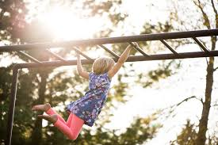
Single Object tracking
MeanShift
Center of mass of intensities inside circle
Center of mass of intensities inside (larger) circle
Size of region-of-interest in current and next frame are fixed

Slide 17
Single Object tracking
CAMShift method (continuous adaptive mean shift)
Center of mass of intensities inside circle
Center of mass of intensities inside (larger) circle
Size of region-of-interest is also adjusted based on covariance of intensities

Slide 18
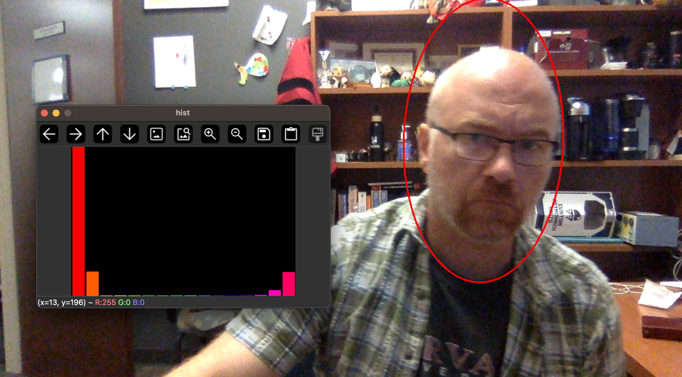
Single Object tracking
CAMShift method (continuous adaptive mean shift)

Slide 19
Boosting tracker
Similar to Haar cascade model
Requires training at runtime with positive/negative data
User labels object to be tracked (or by some detection method)
Given new frame, run classifier on all nearby pixels to previous known location
Update positives/negatives and training as we add frames

Slide 20
MIL (multiple instance learning)
Similar to Boosting tracker, but uses multiple samples around the point to define positive “bags” (collections of images related to the positive image)
Less prone to drift cf Boosting
Better job at partial occlusions than Boost but cannot track over full occlusions

Slide 21
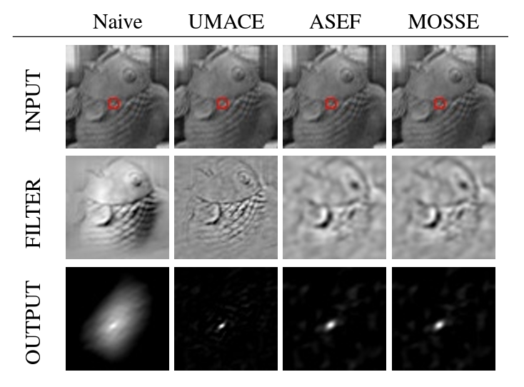
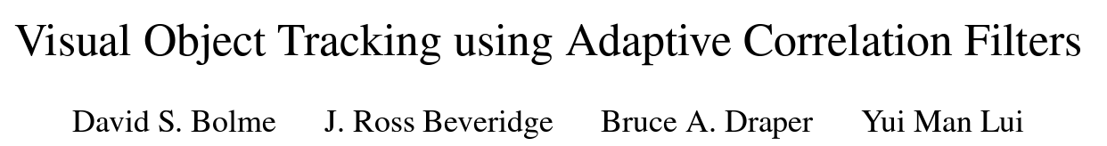
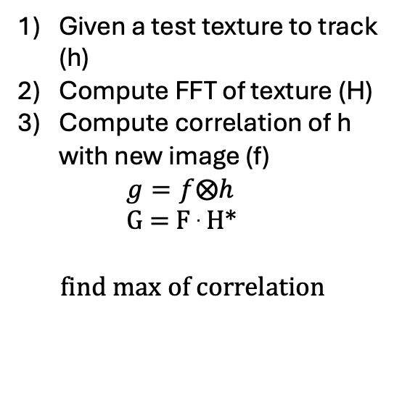
KCF (kernelized correlation function) tracker CSRT (discriminate correlation filter) MOSSE (minimum output sum of squared error
Given a test texture to track (h)
Compute FFT of texture (H)
Compute correlation of h with new image (f)
$g=f⨂h$
G = F . H*
find max of correlation

Slide 22
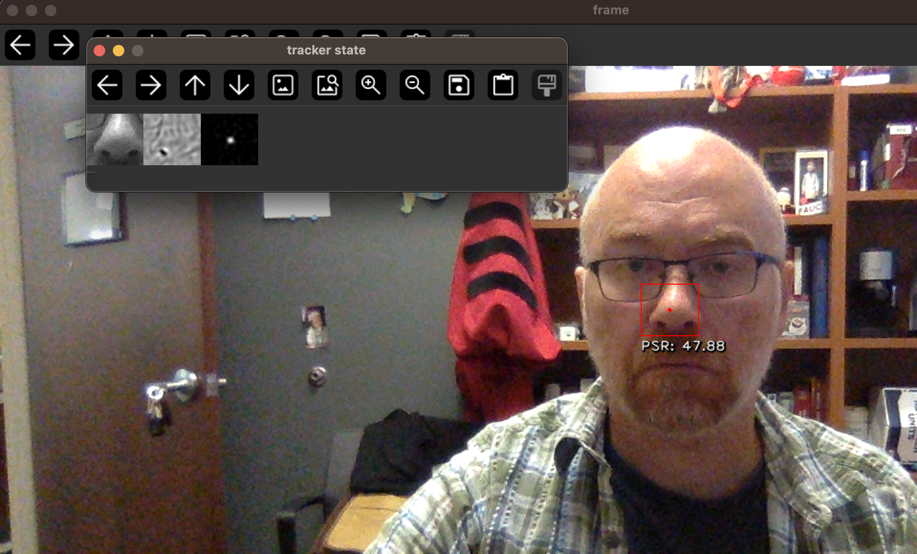

Slide 23
Lecture Notes on Kalman filters

Slide 24
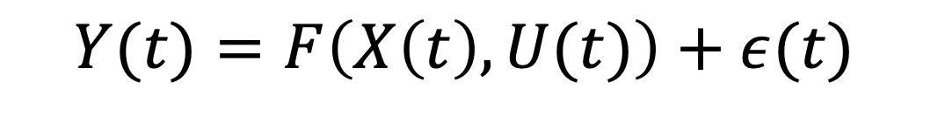
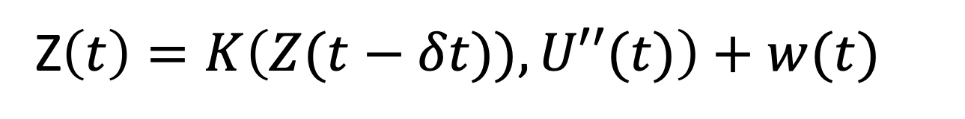
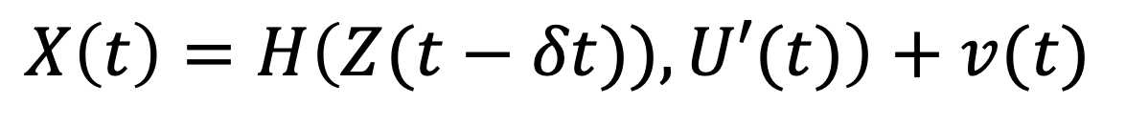
Hierarchical Noise Models
Measurement noise
Measurement (Lead field) model
Observation layer
Observations
$$Y(t)=F\left(X\left(t\right),U(t)\right)+ε(t)$$
Control/Input vector [optional]
State/process noise
Hidden-state layer I
States
$$X\left(t\right)=H\left(Z(t−δt)),U′(t)\right)+v(t)$$
State update model
Hidden-state layer II
Z$\left(t\right)=K\left(Z(t−δt)),U′′(t)\right)+w(t)$

Slide 25
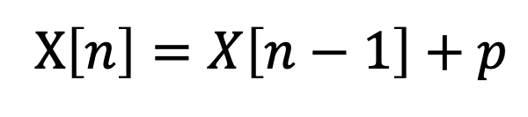
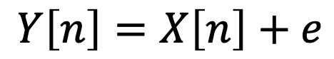
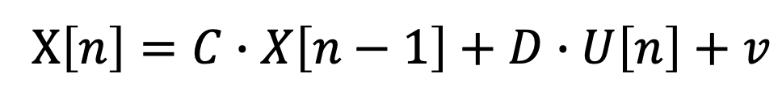
Example
Observation Layer
$\left[\begin{matrix}Y_{lat}[n] \\ Y_{long}[n]\end{matrix}\right]$= $\left[\begin{matrix}X_{lat}[n] \\ X_{long}[n]\end{matrix}\right]+ε$
Position Layer
$$\left[\begin{matrix}X_{lat}[n] \\ X_{long}[n]\end{matrix}\right]=\left[\begin{matrix}X_{lat}[n−1] \\ X_{long}[n−1]\end{matrix}\right]+p$$
$$Y\left[n\right]=X\left[n\right]+e$$
$$Y\left[n\right]=A∙X\left[n\right]+B∙U\left[n\right]+e$$
X$\left[n\right]=X\left[n−1\right]+p$
X$\left[n\right]=C∙X\left[n−1\right]+D∙U\left[n\right]+v$

Slide 26

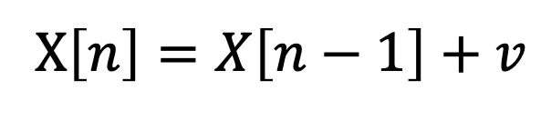
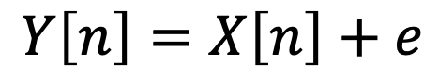
Example
Observation Layer
$$Y\left[n\right]=X\left[n\right]+e$$
$$e=N\left(0,R\right)$$
Position Layer
X$\left[n\right]=X\left[n−1\right]+v$
$$v =N(0,Q)$$

Slide 27
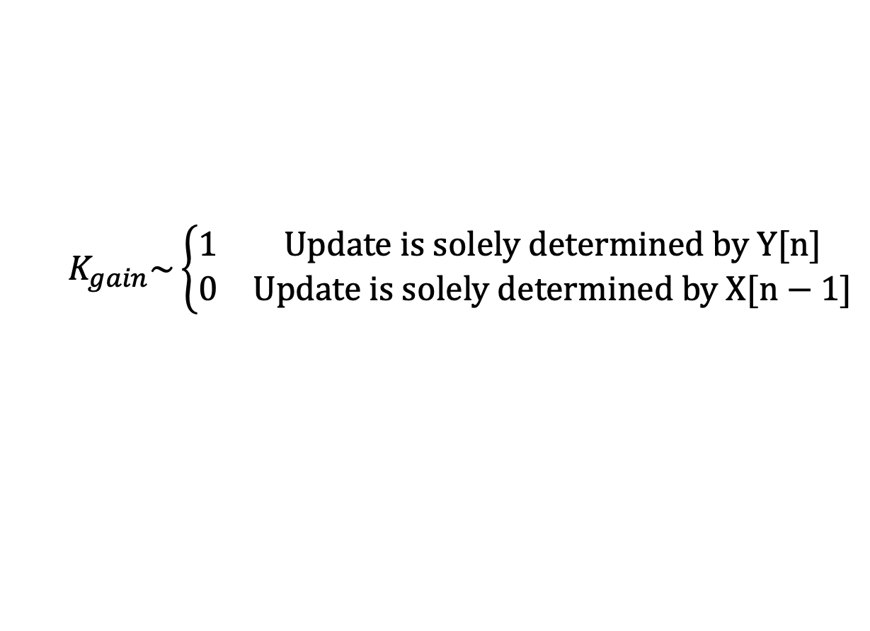
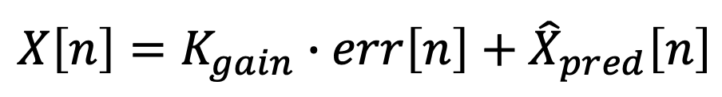
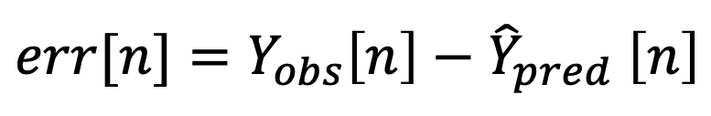

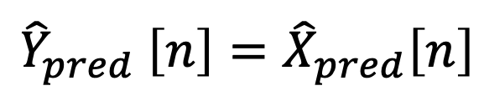
Example
Given X[n-1], where do I expect the car to be at n:
${\hat{X}}_{pred}\left[n\right]$=X[n-1]
$${\hat{Y}}_{pred} \left[n\right]={\hat{X}}_{pred}\left[n\right]$$
After I measure the position, how far off was my estimate:
$$err[n]={Y_{obs}\left[n\right]−\hat{Y}}_{pred} \left[n\right]$$
Update the estimate of X[n] between where I expected it to be and where I measured it :
$$X\left[n\right]=K_{gain}∙err\left[n\right]+{\hat{X}}_{pred}\left[n\right]$$
$$K_{gain}\sim \left\{\begin{matrix}1 & Update is solely determined by Y[n] \\ 0 & Update is solely determined by X[n−1]\end{matrix}\right.$$

Slide 28
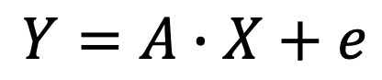

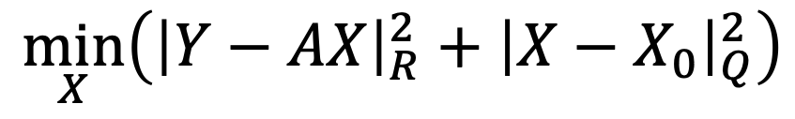
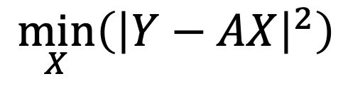
Kalman Gain
$$Y=A∙X+e$$
Least-squares
$$\min_{X}\left({\left|Y−AX\right|}^{2}\right)$$
Prior expectation of X
Weighted Least-squares
$$\min_{X}\left({\left|Y−AX\right|}_{R}^{2}+{\left|X−X_{0}\right|}_{Q}^{2}\right)$$
Notation denotes:
$${|Ψ|}_{Ω}^{2}≡Ψ∙Ω^{−1}∙Ψ^{T}$$

Slide 29
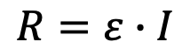
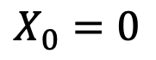
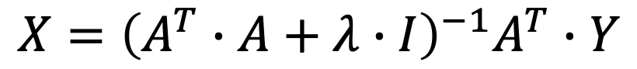
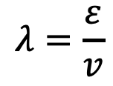
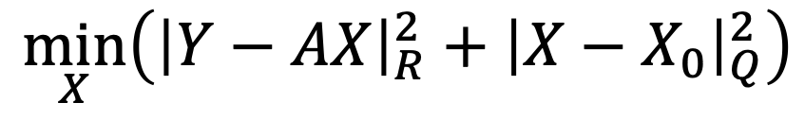

Kalman Gain
$$Y=A∙X+e$$
$$\min_{X}\left({\left|Y−AX\right|}_{R}^{2}+{\left|X−X_{0}\right|}_{Q}^{2}\right)$$
$$X={\left(A^{T}∙R^{−1}∙A+Q^{−1}\right)}^{−1}A^{T}∙R^{−1}∙\left(Y−A∙X_{0}\right)+X_{0}$$
Special Case (Tikhonov regularization/ Ridge regression)
$$R=ε∙I$$
$$λ=\frac{ε}{v}$$
$$X_{0}=0$$
← 1/Signal-to-noise ratio
Q$=v∙I$
$$X={\left(A^{T}∙A+λ∙I\right)}^{−1}A^{T}∙Y$$

Slide 30
Kalman Gain
$$Y=A∙X+e$$
$$\min_{X}\left({\left|Y−AX\right|}_{R}^{2}+{\left|X−X_{0}\right|}_{Q}^{2}\right)$$
$$X={\left(A^{T}∙R^{−1}∙A+Q^{−1}\right)}^{−1}A^{T}∙R^{−1}∙\left(Y−A∙X_{0}\right)+X_{0}$$
$$X\left[n\right]=K_{gain}∙({Y_{obs}\left[n\right]−\hat{Y}}_{pred} \left[n\right])+{\hat{X}}_{pred}\left[n\right]$$
$$X={Q∙A^{T}∙\left(A∙Q∙A^{T}+R\right)}^{−1}∙\left(Y−A∙X_{0}\right)+X_{0}$$

Slide 31








$$Y\left[n\right]=X\left[n\right]+e$$
X$\left[n\right]=X\left[n−1\right]+v$
${\hat{X}}_{pred}\left[n\right]$=X[n-1]
$${\hat{Y}}_{pred} \left[n\right]={\hat{X}}_{pred}\left[n\right]$$
Prediction
$${\hat{P}}_{pred} \left[n\right]=P\left[n\right]+Q$$
$$err[n]={Y_{obs}\left[n\right]−\hat{Y}}_{pred} \left[n\right]$$
$$S\left[n\right]={\hat{P}}_{pred} \left[n\right]+R$$
Update
$K_{gain}$= ${\hat{P}}_{pred} \left[n\right]∙{S\left[n\right]}^{−1}$
$$X\left[n\right]=K_{gain}∙err\left[n\right]+{\hat{X}}_{pred}\left[n\right]$$
Correction
$P\left[n\right]$=$\left(I−K_{gain}\right)∙{\hat{P}}_{pred} \left[n\right]$

Slide 32
$$Y\left[n\right]=A∙X\left[n\right]+B∙U\left[n\right]+e$$
X$\left[n\right]=C∙X\left[n−1\right]+D∙U\left[n\right]+v$
${\hat{X}}_{pred}\left[n\right]$=C $∙$X[n-1]+ $D∙U\left[n\right]$
$${\hat{Y}}_{pred} \left[n\right]=A∙{\hat{X}}_{pred}\left[n\right]+B∙U\left[n\right]$$
Prediction
$${\hat{P}}_{pred} \left[n\right]=C∙P\left[n\right]∙C^{T}+Q$$
$$err[n]={Y_{obs}\left[n\right]−\hat{Y}}_{pred} \left[n\right]$$
$$S\left[n\right]={A∙\hat{P}}_{pred} \left[n\right]∙A^{T}+R$$
Update
$K_{gain}$= ${\hat{P}}_{pred} \left[n\right]∙{A^{T}∙S\left[n\right]}^{−1}$
$$X\left[n\right]=K_{gain}∙err\left[n\right]+{\hat{X}}_{pred}\left[n\right]$$
Correction
$P\left[n\right]$=$\left(I−K_{gain}∙A\right)∙{\hat{P}}_{pred} \left[n\right]$

Slide 33
>> A=eye(2);
>> nk=1000;
>> xtrue = [[1:nk]./200.*sin([1:nk]/50);...
[1:nk]./200.*cos([1:nk]/50)];
>> y=A*xtrue+randn(2,nk)/3;
R=.1*eye(2);
Q=.2*eye(2);
x=zeros(2,nk);
P=eye(2);
for k=2:nk
xhat=C*x(:,k-1);
yhat = A*xhat;
Phat = C*P*C'+Q;
err = y(:,k)-yhat;
S = A*Phat*A'+R;
K = Phat*A'*inv(S);
x(:,k)=xhat+K*err;
P=(eye(2)-K*A)*Phat;
end

Slide 34
>> A=eye(2);
>> nk=1000;
>> xtrue = [[1:nk]./200.*sin([1:nk]/50);...
[1:nk]./200.*cos([1:nk]/50)];
>> y=A*xtrue+randn(2,nk)/3;
R=.1*eye(2);
Q=.2*eye(2);
x=zeros(2,nk);
P=eye(2);
for k=2:nk
xhat=C*x(:,k-1);
yhat = A*xhat;
Phat = C*P*C'+Q;
err = y(:,k)-yhat;
S = A*Phat*A'+R;
K = Phat*A'*inv(S);
x(:,k)=xhat+K*err;
P=(eye(2)-K*A)*Phat;
end

Slide 35
>> A=eye(2);
>> nk=1000;
>> xtrue = [[1:nk]./200.*sin([1:nk]/50);...
[1:nk]./200.*cos([1:nk]/50)];
>> y=A*xtrue+randn(2,nk)/3;
R=2*eye(2);
Q=.2*eye(2);
x=zeros(2,nk);
P=eye(2);
for k=2:nk
xhat=C*x(:,k-1);
yhat = A*xhat;
Phat = C*P*C'+Q;
err = y(:,k)-yhat;
S = A*Phat*A'+R;
K = Phat*A'*inv(S);
x(:,k)=xhat+K*err;
P=(eye(2)-K*A)*Phat;
end

Slide 36
>> A=eye(2);
>> nk=1000;
>> xtrue = [[1:nk]./200.*sin([1:nk]/50);...
[1:nk]./200.*cos([1:nk]/50)];
>> y=A*xtrue+randn(2,nk)/3;
R=20*eye(2);
Q=.2*eye(2);
x=zeros(2,nk);
P=eye(2);
for k=2:nk
xhat=C*x(:,k-1);
yhat = A*xhat;
Phat = C*P*C'+Q;
err = y(:,k)-yhat;
S = A*Phat*A'+R;
K = Phat*A'*inv(S);
x(:,k)=xhat+K*err;
P=(eye(2)-K*A)*Phat;
end

Slide 37












Fixed Interval Smoother
For (k=0; k<n; k++):
For (k=n; k>0; k--):
${\hat{X}}_{k|k−1}$=C $∙X_{k−1|k−1}$+ $D∙U_{k}$
$$M_{k}=P_{k|k}∙A∙{{\hat{P}}_{k+1|k}}^{−1}$$
$${\hat{Y}}_{k} =A∙{\hat{X}}_{k|k−1}+B∙U_{k}$$
$X_{k|n}=$ $X_{k|k}$ + $M_{k} ∙(X_{k+1|n}$ - $X_{k+1|k}$)
$${\hat{P}}_{k|k−1}=C∙P_{k−1|k−1}∙C^{T}+Q$$
$P_{k|n}$= $P_{k|k}+M_{k} ∙(P_{k+1|n}\text{ − }{\hat{P}}_{k+1|k}\text{)}$
$${inn}_{k}={Y_{k}−\hat{Y}}_{k}$$
end
$$S=A∙{\hat{P}}_{k|k−1}∙A^{T}+R$$
$K$= ${\hat{P}}_{k|k−1}∙{A^{T}∙S}^{−1}$
Requires storing the
$X_{k|k}$, $X_{k+1|k}$, $P_{k|k}$, and ${\hat{P}}_{k+1|k}$ from the forward pass
$$X_{k|k}=K∙{inn}_{k}+{\hat{X}}_{k|k−1}$$
$P_{k|k}$=$\left(I−K∙A\right)∙{\hat{P}}_{k|k−1}$
end

Slide 39
Tuning R and Q
R- Measurement noise
Uncertainty in each measurement
Low R → model will simply track the measurements (no filtering)
High Q → model will be independent of the data
Data fusion (use R to weight different measurements)
Q- Process noise
Allowed changes in the state between updates
Low Q → state will be more static
High Q → allows state to vary wildly (less informative)
Ideally Q is the variance(diff(state))

Slide 40
Example
Observation Layer
$\left[\begin{matrix}Y_{lat}[n] \\ Y_{long}[n]\end{matrix}\right]$= $\left[\begin{matrix}X_{lat}[n] \\ X_{long}[n]\end{matrix}\right]+ε$
Position Layer
$\left[\begin{matrix}X_{lat}[n] \\ X_{long}[n]\end{matrix}\right]=\left[\begin{matrix}X_{lat}[n−1] \\ X_{long}[n−1]\end{matrix}\right]$+$T∙\left[\begin{matrix}\cos\left(θ\left[n\right]\right) \\ −\sin\left(θ\left[n\right]\right)\end{matrix}\right]∙V_{elocity}\left[n\right]+p$
Velocity Layer
$\left[\begin{matrix}V_{elocity}\left[n\right] \\ θ[n]\end{matrix}\right]=\left[\begin{matrix}V_{elocity} [n−1] \\ θ[n−1]\end{matrix}\right]$+ $T∙ \left[\begin{matrix}A_{cc}[n] \\ W_{acc}[n]\end{matrix}\right]+v$
Acceleration Layer
$$\left[\begin{matrix}A_{cc}[n] \\ W_{acc}[n]\end{matrix}\right]=\left[\begin{matrix}A_{cc}[n−1] \\ W_{acc}[n−1]\end{matrix}\right]+ω$$

Slide 41



Example
$Y$=$\left[\begin{matrix}1 & 0 & 0 & 0 & 0 & 0 \\ 0 & 1 & 0 & 0 & 0 & 0\end{matrix}\right]∙\left[\begin{matrix}X_{lat} \\ X_{long} \\ X_{velocity} \\ θ_{velocity} \\ X_{accel} \\ θ_{accel}\end{matrix}\right]+ε$
$\left[\begin{matrix}X_{lat} \\ X_{long} \\ X_{velocity} \\ θ_{velocity} \\ X_{accel} \\ θ_{accel}\end{matrix}\right]=B\left(\left[\begin{matrix}X_{lat} \\ X_{long} \\ X_{velocity} \\ θ_{velocity} \\ X_{accel} \\ θ_{accel}\end{matrix}\right]\right)$+ $\left[\begin{matrix}υ_{lat} \\ υ_{long} \\ υ_{velocity} \\ υ_{velocity} \\ υ_{accel} \\ υ_{accel}\end{matrix}\right]$
$$B\left(X\right)=\left[\begin{matrix}X_{lat}+T∗\cos\left(θ_{velocity}\right)∗X_{velocity} \\ X_{long}−T∗\sin\left(θ_{velocity}\right)∗X_{velocity} \\ X_{velocity}+T∗X_{accel} \\ θ_{velocity}+T∗θ_{accel} \\ 1 \\ 1\end{matrix}\right]$$

Slide 42

Example
$Y$=$\left[\begin{matrix}1 & 0 & 0 & 0 & 0 & 0 \\ 0 & 1 & 0 & 0 & 0 & 0\end{matrix}\right]∙\left[\begin{matrix}X_{lat} \\ X_{long} \\ X_{velocity} \\ θ_{velocity} \\ X_{accel} \\ θ_{accel}\end{matrix}\right]+ε$
$\left[\begin{matrix}dX_{lat}/dt \\ {dX}_{long}/dt \\ {dX}_{velocity}/dt \\ {dθ}_{velocity}/dt \\ {dX}_{accel}/dt \\ {dθ}_{accel}/dt\end{matrix}\right] =\left[\begin{matrix}1 & 0 & T∙\cos\left(θ_{velocity}\right) & −T∙X_{velocity}∙\sin\left(θ_{velocity}\right) & 0 & 0 \\ 0 & 1 & −T∙sin\left(θ_{velocity}\right) & T∙X_{velocity}∙cos\left(θ_{velocity}\right) & 0 & 0 \\ 0 & 0 & 1 & 0 & T & 0 \\ 0 & 0 & 0 & 1 & 0 & T \\ 0 & 0 & 0 & 0 & 1 & 0 \\ 0 & 0 & 0 & 0 & 0 & 1\end{matrix}\right]∙\left[\begin{matrix}dX_{lat}/dt \\ {dX}_{long}/dt \\ {dX}_{velocity}/dt \\ {dθ}_{velocity}/dt \\ {dX}_{accel}/dt \\ {dθ}_{accel}/dt\end{matrix}\right]$+ $\left[\begin{matrix}υ_{lat} \\ υ_{long} \\ υ_{velocity} \\ υ_{velocity} \\ υ_{accel} \\ υ_{accel}\end{matrix}\right]$
Advantages-
Model is restricted by real-world physics. (e.g. instantaneous velocity changes are not possible)
More control over the sources of noise/error

Slide 43












$$Y\left[n\right]=H(X\left[n\right],U\left[n\right])+e$$
X$\left[n\right]=F(X\left[n−1\right],U\left[n\right])+v$
${\hat{X}}_{pred}\left[n\right]$=F( X[n-1],$U\left[n\right])$
$${\hat{Y}}_{pred} \left[n\right]=H({\hat{X}}_{pred}\left[n\right], U\left[n\right])$$
Prediction
$${\hat{P}}_{pred} \left[n\right]=F′∙P\left[n\right]∙{F′}^{T}+Q$$
$$F^{′}={\left.\frac{∂F}{∂X}\right|}_{{\hat{X}}_{pred}\left[n\right]}$$
$$err[n]={Y_{obs}\left[n\right]−\hat{Y}}_{pred} \left[n\right]$$
$$S\left[n\right]={H′∙\hat{P}}_{pred} \left[n\right]∙{H′}^{T}+R$$
Update
$$H^{′}={\left.\frac{∂H}{∂X}\right|}_{{\hat{Y}}_{pred} \left[n\right]}$$
$K_{gain}$= ${\hat{P}}_{pred} \left[n\right]∙{{H′}^{T}∙S\left[n\right]}^{−1}$
$$X\left[n\right]=K_{gain}∙err\left[n\right]+{\hat{X}}_{pred}\left[n\right]$$
Correction
$P\left[n\right]$=$\left(I−K_{gain}∙H′\right)∙{\hat{P}}_{pred} \left[n\right]$

